Slide 1

Chapter 12 – Object-Oriented Design

Slide 2
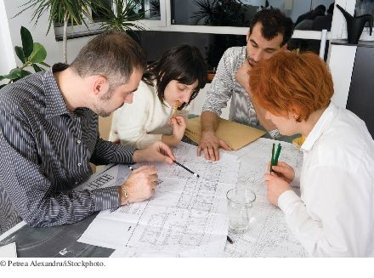
Chapter Goals
To learn how to discover new classes and methods To use CRC cards for class discovery
To identify inheritance, aggregation, and dependency relationships between classes
To describe class relationships using UML class diagrams
To apply object-oriented design techniques to building complex programs

Slide 3
Discovering Classes
When designing a program, you work from a requirements specification
The designer’s task is to discover structures that make it possible to implement the requirements
To discover classes, look for nouns in the problem description.
Find methods by looking for verbs in the task description.

Slide 4
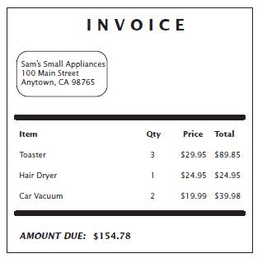
Example: Invoice
Figure 1 An Invoice

Slide 5
Example: Invoice
Classes that come to mind:
Invoice LineItem Customer
Good idea to keep a list of candidate classes. Brainstorm: put all ideas for classes onto the list. Cross not useful ones later.
Concepts from the problem domain are good candidates for classes.
Not all classes can be discovered from the program requirements:
Most programs need tactical classes

Slide 6
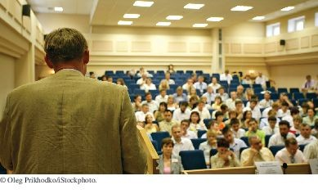
The CRC Card Method
In a class scheduling system, potential classes from the problem domain include Class, LectureHall, Instructor, and Student.

Slide 7
The CRC Card Method
After you have a set of classes
Define the behavior (methods) of each class
Look for verbs in the task description
Match the verbs to the appropriate objects
The invoice program needs to compute the amount due
Which class is responsible for this method?
Invoice class

Slide 8
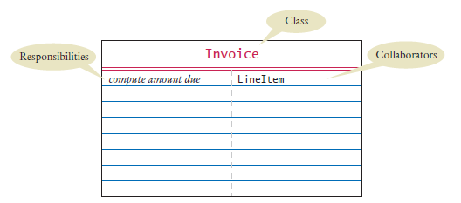
The CRC Card Method
To find the class responsibilities, use the CRC card method. A CRC card describes a class, its responsibilities, and its collaborating classes.
CRC - stands for “classes”, “responsibilities”, “collaborators”
Use an index card for each class.
Pick the class that should be responsible for each method (verb).
Write the responsibility onto the class card.
Indicate what other classes are needed to fulfill responsibility (collaborators).
Figure 2 A CRC Card

Slide 9
Self Check 12.1
What is the rule of thumb for finding classes?
Answer: Look for nouns in the problem description.

Slide 10
Self Check 12.2
Your job is to write a program that plays chess. Might ChessBoard be an appropriate class? How about MovePiece?
Answer: Yes (ChessBoard) and no (MovePiece).

Slide 11
Self Check 12.3
Suppose the invoice is to be saved to a file. Name a likely collaborator.
Answer: PrintStream

Slide 12
Self Check 12.4
Looking at the invoice in Figure 1, what is a likely responsibility of the Customer
class?
Answer: To produce the shipping address of the customer.

Slide 13
Self Check 12.5
What do you do if a CRC card has ten responsibilities?
Answer: Reword the responsibilities so that they are at a higher level, or come up with more classes to handle the responsibilities.

Slide 14
Relationships Between Classes
The most common types of relationships:
Dependency Aggregation Inheritance

Slide 15
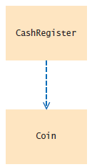
Dependency
A class depends on another class if it uses objects of that class.
The “knows about” relationship.
Example: CashRegister depends on Coin
Figure 3 Dependency Relationship Between the
CashRegiste and Coin Classes

Slide 16
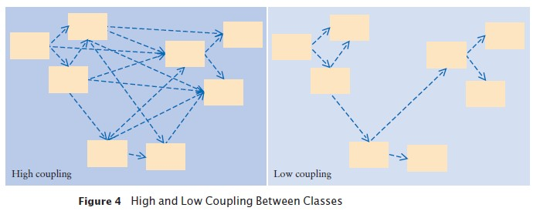
Dependency
It is a good practice to minimize the coupling (i.e., dependency) between classes.
When a class changes, coupled classes may also need updating.

Slide 17
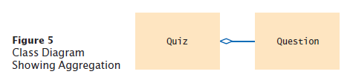
Aggregation
A class aggregates another if its objects contain objects of the other class.
Has-a relationship
Example: a Quiz class aggregates a Question class. The UML for aggregation:
Aggregation is a stronger form of dependency.
Use aggregation to remember another object between method calls.
Use an instance variable
public class Quiz
{

Slide 18
private ArrayList<Question> questions;
. . .
}
A class may use the Scanner class without ever declaring an instance variable of class Scanner.
This is dependency NOT aggregation

Slide 19
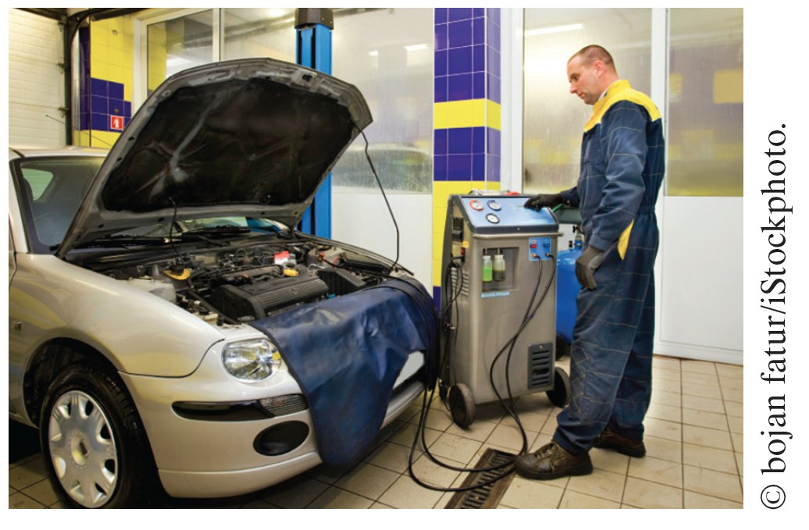
Aggregation
A car has a motor and tires. In object-oriented design, this “has-a” relationship is called aggregation.

Slide 20
Inheritance
Inheritance is a relationship between a more general class (the superclass) and a more
specialized class (the subclass).
The “is-a” relationship.
Example: Every truck is a vehicle.
Inheritance is sometimes inappropriately used when the has-a relationship would be more appropriate.
Should the class Tire be a subclass of a class Circle? No
A tire has a circle as its boundary Use aggregation
public class Tire
{
private String rating; private Circle boundary;
. . .
}

Slide 21
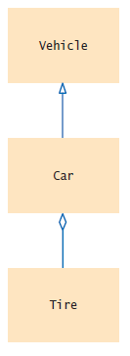
Inheritance
Every car is a vehicle. (Inheritance)
Every car has a tire (or four). (Aggregation)
class Car extends Vehicle
{
private Tire[] tires;
. . .
}
Aggregation denotes that objects of one class contain references to objects of another class.
Figure 6 UML Notation for Inheritance and Aggregation

Slide 22
UML Relationship Symbols
Relationship Inheritance | Symbol | Line Style Solid | Arrow Tip Triangle
Interface Implementation |  | Dotted | Triangle
Aggregation |  | Solid | Diamond
Dependency |  | Dotted | Open

Slide 23
Self Check 12.6
Consider the CashRegisterTester class of Section 8.2. On which classes does it depend?
Answer: The CashRegisterTester class depends on the
CashRegister, Coin, and System classes.

Slide 24
Self Check 12.7
Consider the Question and ChoiceQuestion objects of Chapter 9. How are they related?
Answer: The ChoiceQuestion class inherits from the
Question class.

Slide 25
Self Check 12.8
Consider the Quiz class described in Section 12.2.2. Suppose a quiz contains a mixture of Question and ChoiceQuestion objects. Which classes does the Quiz class depend on?
Answer: The Quiz class depends on the Question class but probably not ChoiceQuestion, if we assume that the methods of the Quiz class manipulate generic Question objects, as they did in Chapter 9.

Slide 26
Self Check 12.9
Why should coupling be minimized between classes?
Answer: If a class doesn’t depend on another, it is not affected by interface changes in the other class.

Slide 27

Self Check 12.10
In an e-mail system, messages are stored in a mailbox. Draw a UML diagram that shows the appropriate aggregation relationship.
Answer:

Slide 28
Self Check 12.11
You are implementing a system to manage a library, keeping track of which books are checked out by whom. Should the Book class aggregate Patron or the other way around?
Answer: Typically, a library system wants to track which books a patron has checked out, so it makes more sense to have Patron aggregate Book. However, there is not always one true answer in design. If you feel strongly that it is important to identify the patron who checked out a particular book (perhaps to notify the patron to return it because it was requested by someone else), then you can argue that the aggregation should go the other way around.

Slide 29
Self Check 12.12
In a library management system, what would be the relationship between classes
Patron and Author?
Answer: There would be no relationship.

Slide 30
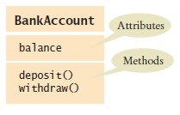
Attributes and Methods in UML Diagrams

Slide 31
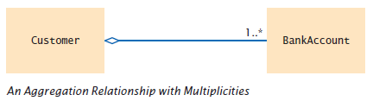
Multiplicities
any number (zero or more): * one or more: 1..*
zero or one: 0..1 exactly one: 1

Slide 32
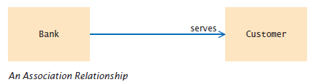
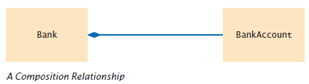
Aggregation and Association, and Composition
Association: More general relationship between classes. Use early in the design phase.
A class is associated with another if you can navigate from objects of one class to objects of the other.
Given a Bank object, you can navigate to Customer objects.
Composition: one of the classes can not exist without the other.

Slide 33
Application: Printing an Invoice
Five-part program development process
Gather requirements
Use CRC cards to find classes, responsibilities, and collaborators
Use UML diagrams to record class relationships
Use javadoc to document method behavior
Implement your program

Slide 34
Application: Printing an Invoice — Requirements
Start the development process by gathering and documenting program requirements.
Task: Print out an invoice
Invoice: Describes the charges for a set of products in certain quantities.
Omit complexities
Dates, taxes, and invoice and customer numbers
Print invoice
Billing address, all line items, amount due
Line item
Description, unit price, quantity ordered, total price
For simplicity, do not provide a user interface.
Test program: Adds line items to the invoice and then prints it.

Slide 35
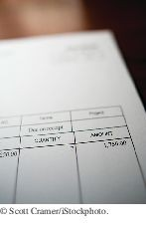
Application: Printing an Invoice
Sample Invoice
I N V O I C E
Sam's Small Appliances
100 Main Street
Anytown, CA Description | 98765 | Price | Qty | Total
Toaster |  | 29.95 | 3 | 89.85
Hair dryer |  | 24.95 | 1 | 24.95
Car vacuum |  | 19.99 | 2 | 39.98
AMOUNT DUE: | $154.78
An invoice lists the charges for each item and the amount due.

Slide 36
Application: Printing an Invoice — CRC Cards
Use CRC cards to find classes, responsibilities, and collaborators.
Discover classes
Nouns are possible classes:
Invoice Address LineItem Product Description Price Quantity Total Amount Due

Slide 37
Application: Printing an Invoice — CRC Cards
Analyze classes:
Invoice Address LineItem Product
// Records the product and the quantity
Description // Field of the Product class Price // Field of the Product class Quantity // Not an attribute of a Product Total // Computed — not stored anywhere Amount Due // Computed — not stored anywhere
Classes after a process of elimination:
Invoice Address LineItem Product

Slide 38
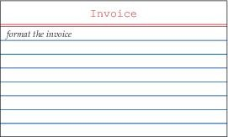
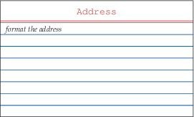
CRC Cards for Printing Invoice
Invoice and Address must be able to format themselves:

Slide 39
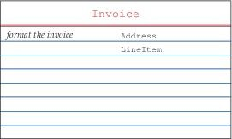
CRC Cards for Printing Invoice
Add collaborators to Invoice card:

Slide 40
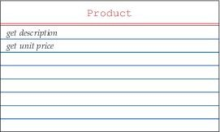
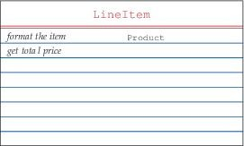
CRC Cards for Printing Invoice
Product and LineItem CRC cards:

Slide 41
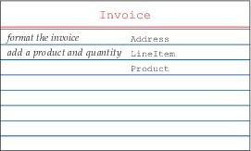
CRC Cards for Printing Invoice
Invoice must be populated with products and quantities:

Slide 42
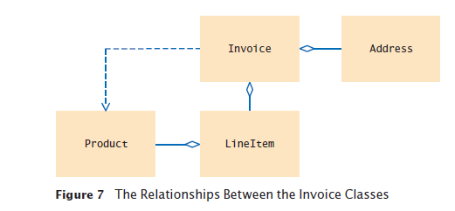
Application: Printing an Invoice — UML Diagrams

Slide 43
Printing an Invoice — Method Documentation
Use javadoc comments (with the method bodies left blank) to record the behavior of the classes.
Write a Java source file for each class:
Write the method comments for those methods that you have discovered,
Leave the body of the methods blank
Run javadoc to obtain formatted version of documentation in HTML format.
Advantages:
Share HTML documentation with other team members Format is immediately useful: Java source files
Supply the comments of the key methods

Slide 44
Method Documentation — Invoice
Class
/**
Describes an invoice for a set of purchased products.
*/
public class Invoice
{
/**
Adds a charge for a product to this invoice.
@param aProduct the product that the customer ordered
@param quantity the quantity of the product
*/
public void add(Product aProduct, int quantity)
{
}
/**
Formats the invoice.
@return the formatted invoice
*/
public String format()
{
}
}

Slide 45
Method Documentation — LineItem
Class
/**
Describes a quantity of an article to purchase and its price.
*/
public class LineItem
{
/**
Computes the total cost of this line item.
@return the total price
*/
public double getTotalPrice()
{
}
/**
Formats this item.
@return a formatted string of this line item
*/
public String format()
{
}
}

Slide 46
Method Documentation — Product
Class
/**
Describes a product with a description and a price.
*/
public class Product
{
/**
Gets the product description.
@return the description
*/
public String getDescription()
{
}
/**
Gets the product price.
@return the unit price
*/
public double getPrice()
{
}
}

Slide 47
Method Documentation — Address
Class
/**
Describes a mailing address.
*/
public class Address
{
/**
Formats the address.
@return the address as a string with three lines
*/
public String format()
{
}
}

Slide 48
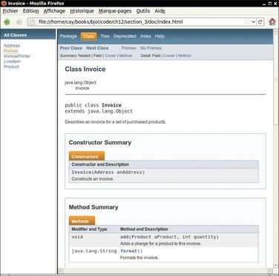
The Class Documentation in the HTML Format
Figure 8 Class Documentation in HTML Format

Slide 49
Printing an Invoice — Implementation
After completing the design, implement your classes. The UML diagram will give instance variables:
Look for aggregated classes They yield instance variables

Slide 50
Implementation
Invoice aggregates Address and LineItem. Every invoice has one billing address.
An invoice can have many line items:
public class Invoice
{
. . .
private Address billingAddress; private ArrayList<LineItem> items;
}

Slide 51
Implementation
A line item needs to store a Product object and quantity:
public class LineItem
{
. . .
private int quantity; private Product theProduct;
}

Slide 52
Implementation
The methods themselves are now very easy. Example:
getTotalPrice of LineItem gets the unit price of the product and multiplies it with the quantity
/**
Computes the total cost of this line item.
@return the total price
*/
public double getTotalPrice()
{
return theProduct.getPrice() * quantity;
}
Also supply constructors

Slide 53
section_3/InvoicePrinter.java
1 /**
This program demonstrates the invoice classes by printing
a sample invoice.
4 */
5 public class InvoicePrinter
6 {
7 public static void main(String[] args)
8 {
9 Address samsAddress

Slide 54
section_3/Invoice.java
1 import java.util.ArrayList;
2
3 /**
4 Describes an invoice for a set of purchased products.
5 */
6 public class Invoice
7 {
private Address billingAddress;
private ArrayList<LineItem> items;

Slide 55
section_3/LineItem.java
1 /**
2 Describes a quantity of an article to purchase.
3 */
4 public class LineItem
5 {
private int quantity;
private Product theProduct;
8
9
/**

Slide 56
section_3/Product.java
1 /**
2 Describes a product with a description and a price.
3 */
4 public class Product
5 {
private String description;
private double price;
8
9
/**

Slide 57
section_3/Address.java
1 /**
2 Describes a mailing address.
3 */
4 public class Address
5 {
private String name;
private String street;
private String city;
private String state;

Slide 58
Self Check 12.13
Which class is responsible for computing the amount due? What are its collaborators for this task?
Answer: The Invoice class is responsible for computing the amount due. It collaborates with the LineItem class.

Slide 59
Self Check 12.14
Why do the format methods return String objects instead of directly printing to
System.out?
Answer: This design decision reduces coupling. It enables us to reuse the classes when we want to show the invoice in a dialog box or on a web page.

